Slide 1
Statistical Methodology for
Software Engineering
Hadas Lapid, PhD
Statistics for SoftwareEngineers
© Hadas Lapid all rights reserved
Notes:
An Introduction to Statistical Methods and Data Analysis 7th Edition
R. Lyman Ott Michael Longnecker
Chap. 10, page 482

Slide 2
Contents
Analysis of Contingency Tables
Based on chapter 10 in the book
Statistics for SoftwareEngineers
© Hadas Lapid all rights reserved

Slide 3
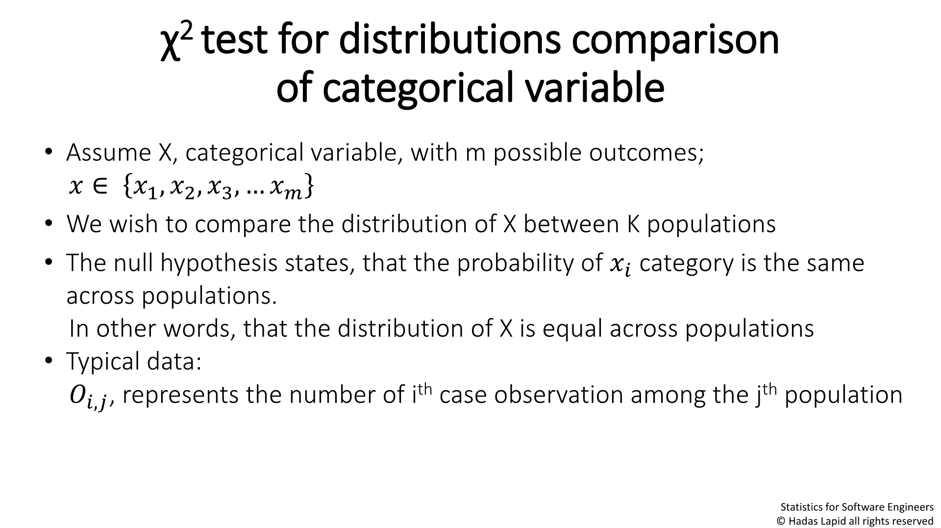

χ²test for distributions comparison
of categorical variable
• Assume X, categorical variable, with m possible outcomes;
෍ ∈
෍ ,෍ ,෍ ,…෍෍
1 2 3
• We wish to compare the distribution of X between K populations
• The null hypothesis states, that the probability of෍෍ category is the
same across populations.
In other words, that the distribution of X is equal across populations
• Typical data:
ꢀꢀ,ꢀ, represents the number of i^{th}case observation among the j^{th}population
Statistics for SoftwareEngineers
© Hadas Lapid all rights reserved
Notes:
An Introduction to Statistical Methods and Data Analysis 7th Edition
R. Lyman Ott Michael Longnecker
Chap. 10, page 482
K אוכלוסיות – אוכלסיה j
m קלסות לקטגוריה – קלסה I
Chap 10.4, Page 501
Inferences About Several Proportions:
Chi-Square Goodness-of-Fit Test
The Multinomial Experiment

Slide 4
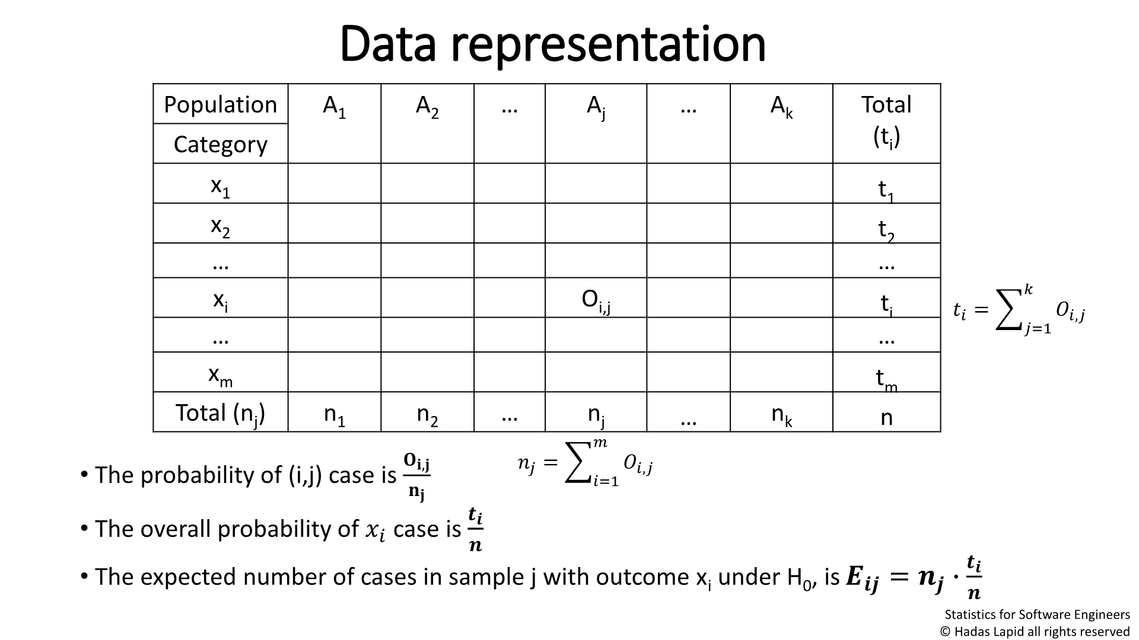

Data representation
Population A₁
Category
x₁
A₂
…
A_{j}
…
A_{k}
Total
(t_{i})
t₁
x₂
…
t₂
…
^{x}i
…
^{O}i,j
t_{i}
…
ꢀ
෍ =෍ ꢀ
෍
ꢀ,ꢀ
ꢀ=1
x_{m}
t_{m}
n
Total (n_{j}) n₁
n₂
…
n
…
n_{k}
j
ꢀ
• The probability of (i,j) case is
෍ =෍ ꢀ
෍
ꢀ,ꢀ
෍
ꢀ=1
෍,෍
ꢀꢀ
• The overall probability of
෍෍
Statistics for SoftwareEngineers
© Hadas Lapid all rights reserved
Notes:
Aj(X) – j’th class of A category
Aj(Xi) – I’th state of j’th class of A category
N = sum(Nj) = sum(Ti)
P(Xj) =
Page 501
expected number of outcomes cell probabilities observed cell counts expected cell counts
Chi-Square Goodness-of-Fit Test
10.5, Page 508
Contingency Tables: Tests for Independence and Homogeneity
Move from counts to probabilities
nj = SUMi(Oij)
ti = SUMj(Oij)
P(i,j) = Oij / nj
P(xi) = ti/n
Eij = nj*P(xi)
X^2 = SUMij { (Oij - Eij)^2/Eij }

Slide 5
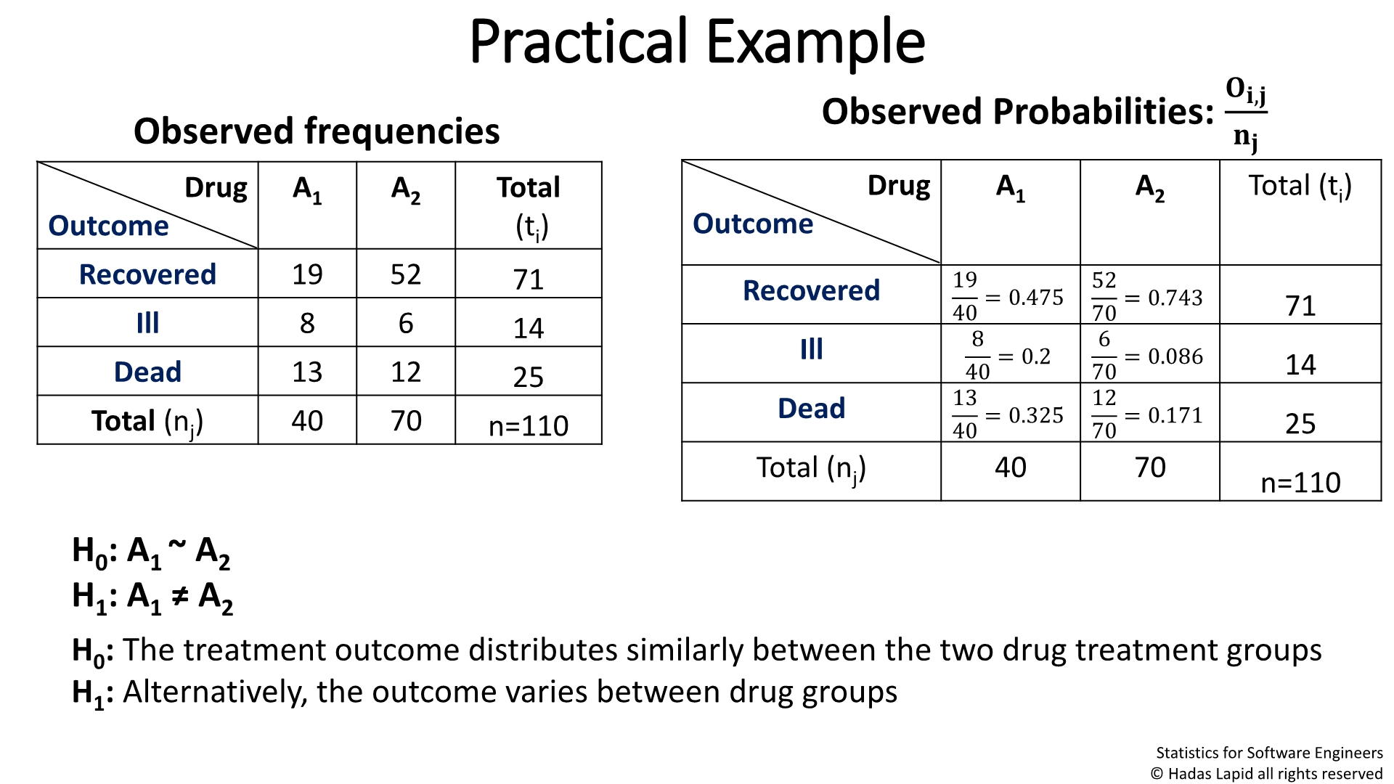
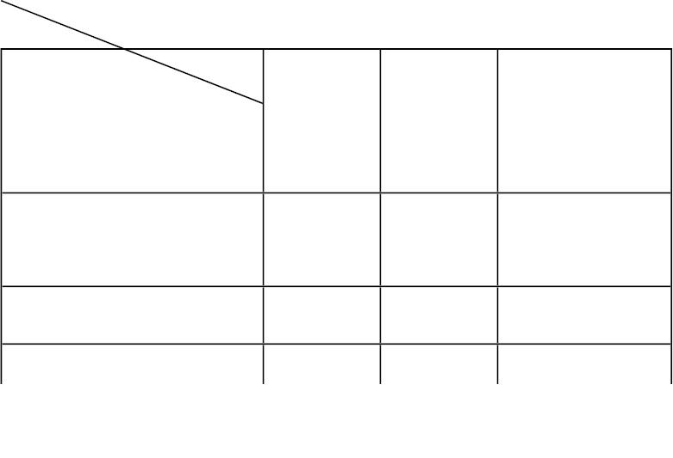
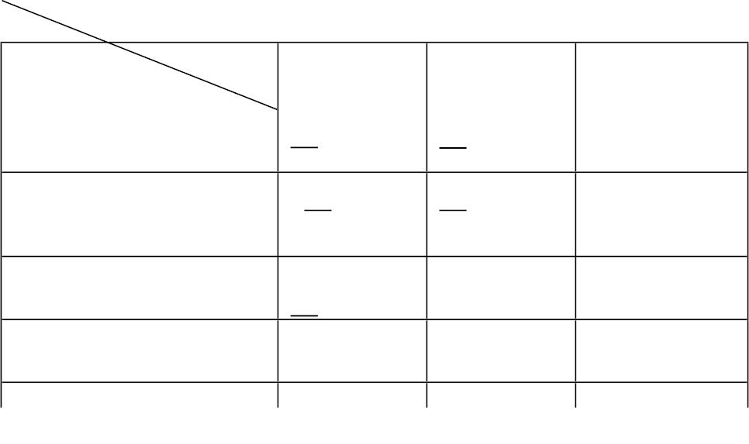
Practical Example
ꢀꢀ,ꢀ
Observed Probabilities:
Observed
frequencies
ꢀꢀ
^{Dru A}1
g
^{A}2
Total
Dru
g
A₁
A₂
Total (t_{i})
(t_{i})
Outcome
Outcome
Recover
ed
19 52
71
Recover
19
40
52
70
= 0.475
= 0.2
= 0.743
71
ed
Ill
Ill
8
6
14
25
8
6
= 0.086
= 0.171
70
14
25
40
13
70
12
Dead
13 12
Dead
= 0.325
40
70
Total (n )
40
H : A ~ A
0
1
2
2
H : A ≠ A
1
1
H₀: The treatment outcome distributes similarly between the two drug treatment groups
Statistics for SoftwareEngineers
© Hadas Lapid all rights reserved
Notes:
Page 508
x2 Test of Independence
df for table

Slide 6
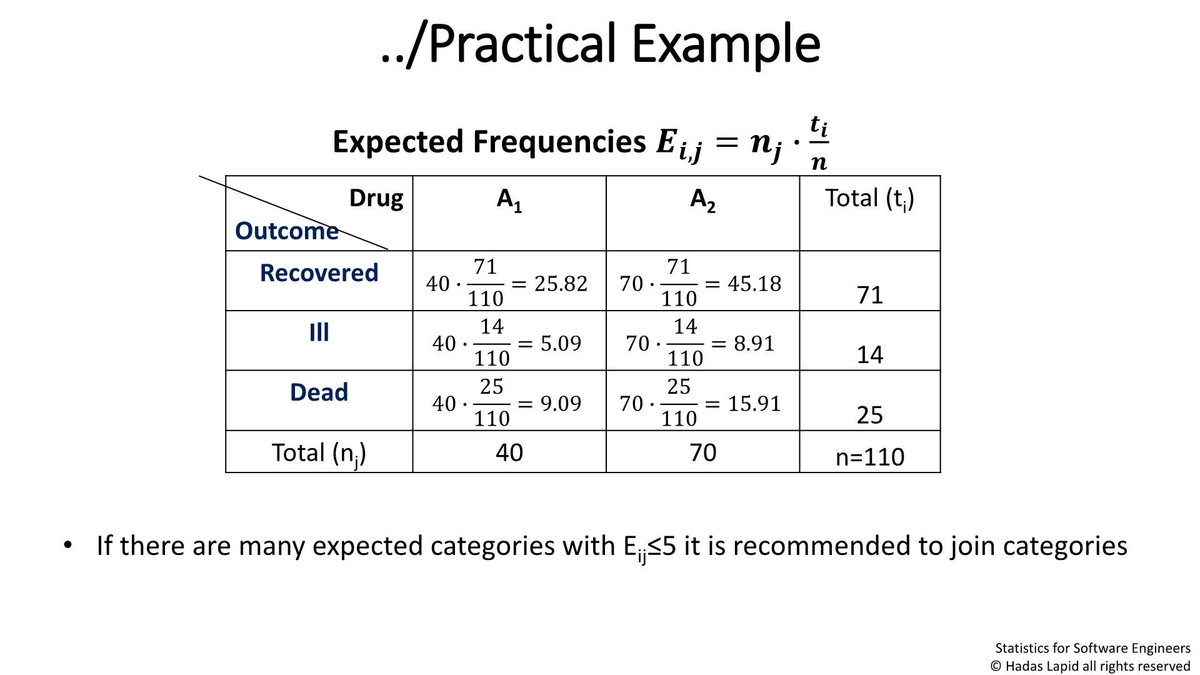
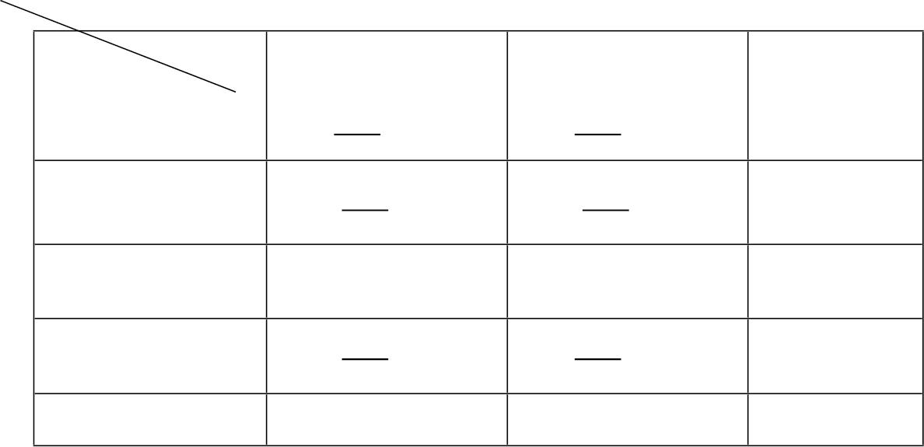
../Practical Example
Expected
Frequencies
ꢀ ∙෍
=
෍
ꢀ,ꢀ
ꢀ
ꢀ
Dru
g
A₁
A₂
Total (t_{i})
Outcome
Recover
ed
71
71
40 ∙
= 25.82
70 ∙
= 45.18
71
14
110
110
Ill
14
14
40 ∙
40 ∙
= 5.09
= 9.09
70 ∙
= 8.91
110
25
110
25
Dead
70 ∙
= 15.91
25
110
110
Total (n_{j})
40
70
n=110
• If there are many expected categories with E_{ij}≤5it is recommended to join categories
Statistics for SoftwareEngineers
© Hadas Lapid all rights reserved

Slide 7
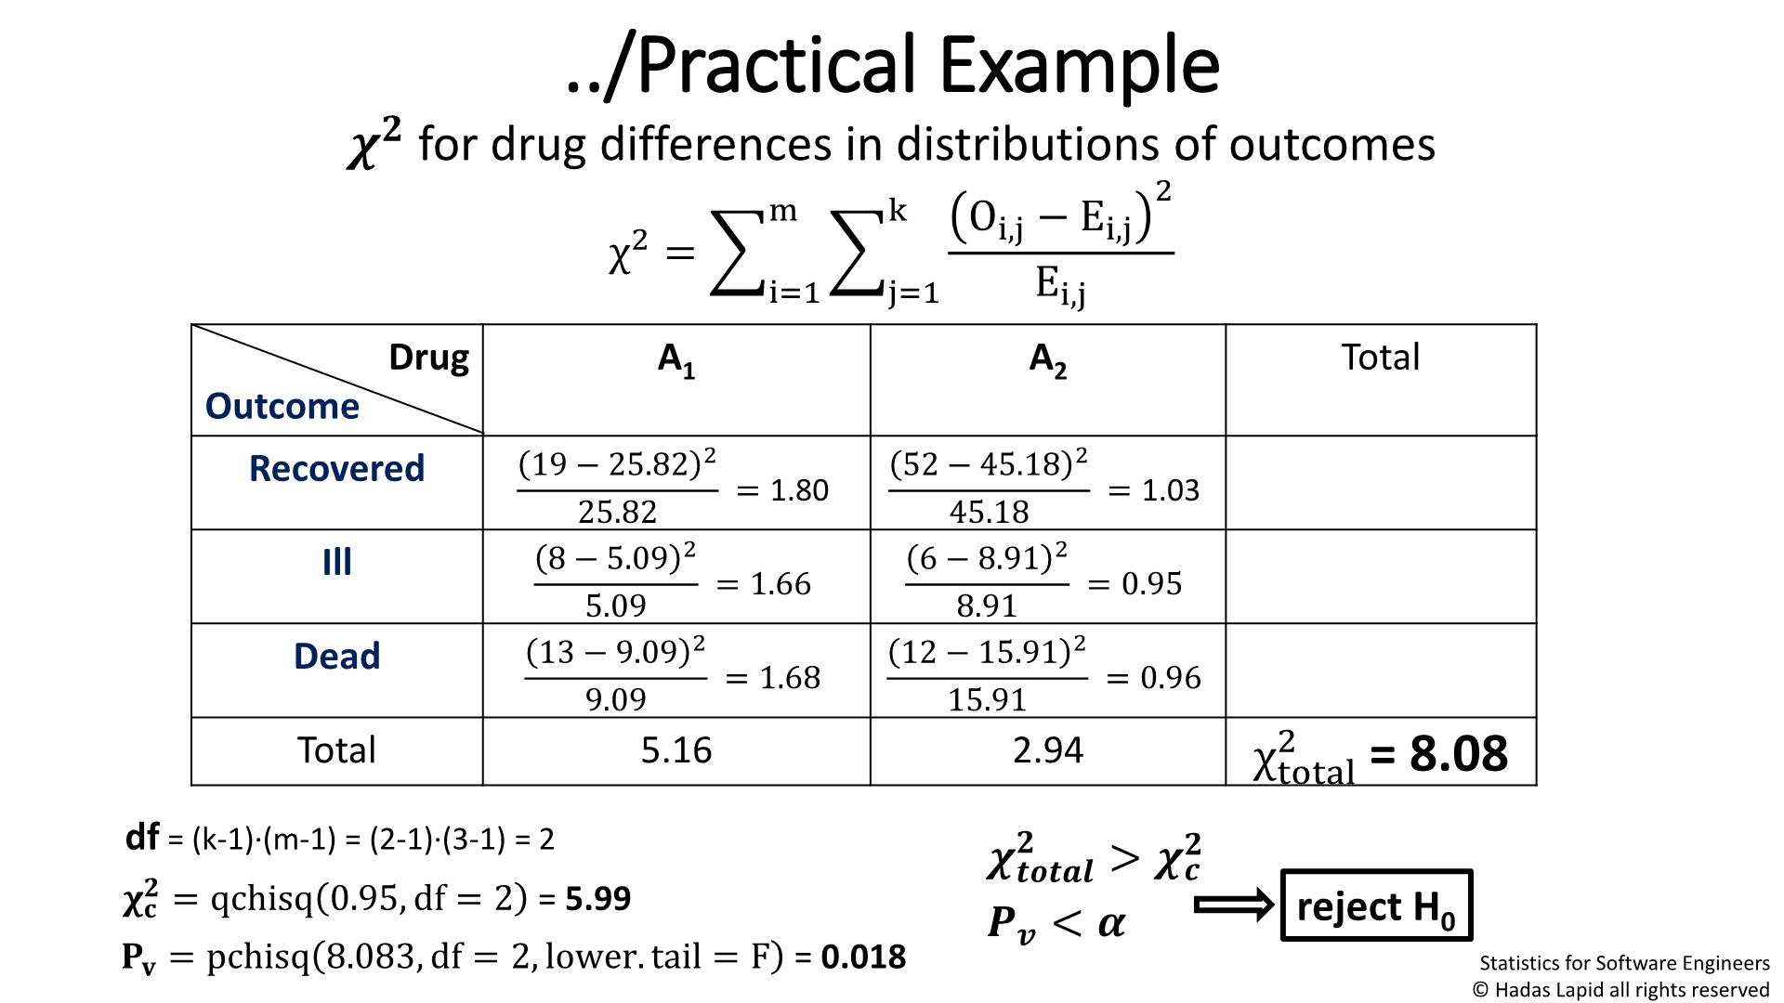

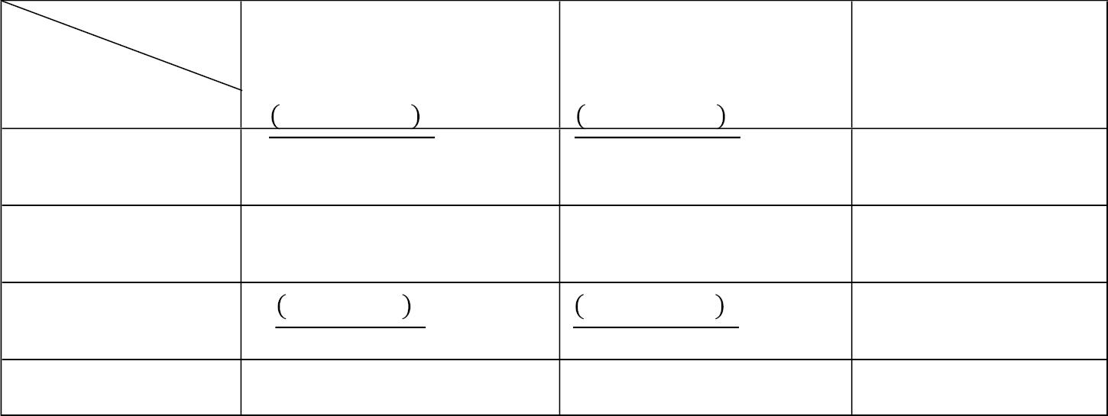
../Practical Example
ꢀꢀ for drug differences in distributions of outcomes
m
k O_{i,j} −E_{i,j}
2
χ² =෍ ෍
i=1
j=1
^{E}i,j
Dru
g
A₁
A₂
Total
Outcome
Recovered
19 − 25.82 ²
52 − 45.18 ²
= 1.80
= 1.03
= 0.95
25.82
8 − 5.09 ²
45.18
6 − 8.91 ²
Ill
5.09
13 − 9.09 ²
= 1.66
= 1.68
8.91
12 − 15.91 ²
Dead
Total
9.09
15.91
=0.96
5.16
2.94
2 = 8.08
χ
total
df=(k-1)∙(m-1)=(2-1)∙(3-1)=
ꢀꢀ
> ꢀꢀ
2
© Hadas Lapid all rights reserved
Notes:
Chap 10.4 page 503
The difference between X^2 applied as a goodness of fit and X^2 applied for comparison of categorical distributions is that the 1’st is used to compare an observed distribution to known population of distribution
and the 2’nd is used to estimate the deviation of a group of populations from their expected mean
X^2 total > X^2 C
Pv = 0.018 < alpha = 0.05

Slide 8
Cell-χ²and cell-percentage analysis
• χ² analysis demonstrates the strength of a relation between groups and categories.
• Percentage/probability analysis shows how strong the relation is.
• The two types of analyses are complementary.
Statistics for SoftwareEngineers
© Hadas Lapid all rights reserved
Notes:
A x2 goodness-of-fit test compares counts to theoretical probabilities that are specified outside the data.
In contrast, a x2 independence test compares counts in one subset (one row, for example) to counts in other rows within the data.
One way to decide which test is needed is to ask whether there is an externally stated set of theoretical probabilities. If so, the goodness-of-fit test is in order

Slide 9
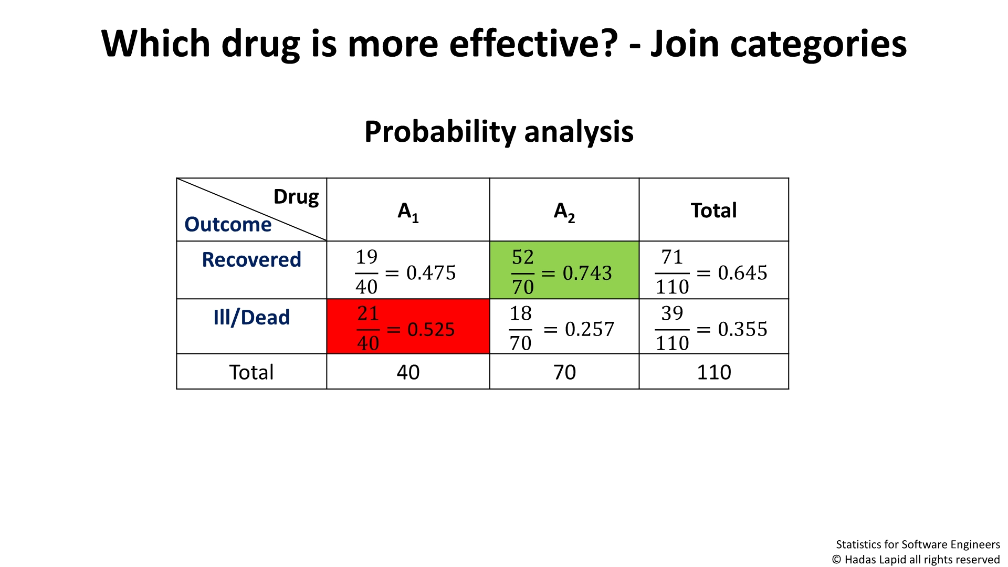
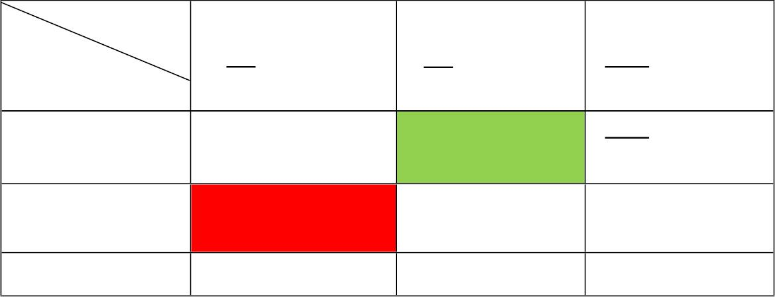
Which drug is more effective? - Join
categories
Probability analysis
Drug
A₁
A₂
Tota
l
Outcome
Recover
ed
Ill/Dead
19
52
71
= 0.475
= 0.743
= 0.645
40
21
70
18
110
39
=0.525
= 0.257
= 0.355
40
70
110
Total
40
70
110
Statistics for SoftwareEngineers
© Hadas Lapid all rights reserved
Notes:
Ill/Dead = Ill + Dead
כאשר מצרפים 2 קטגוריות ומחשבים את ההסתברויות של כל תא, רואים בברור את השוני באפקטיביות של כל תרופה:
בתרופה 1A יש הסתברות גדולה מ 50% למחלה או תמותה בעוד
שבתרופה 2A הסתברות ההבראה קרובה ל 75%
לכן, בברור תרופה 2A אפקטיבית יותר

Slide 10
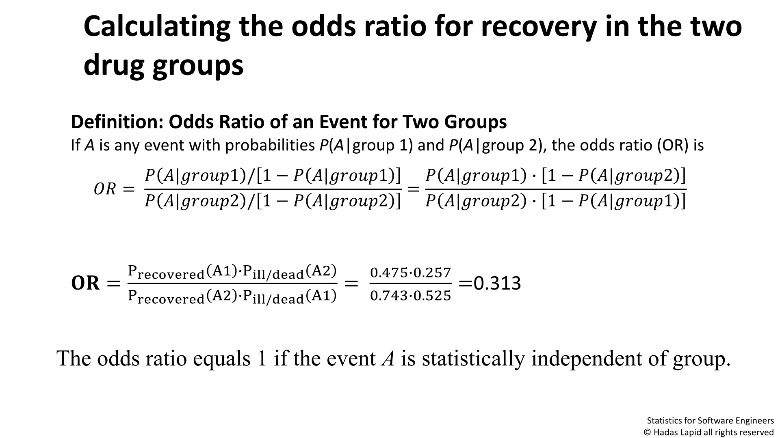








Calculating the odds ratio for recovery in the
two
drug groups
Definition: Odds Ratio of an Event for Two Groups
IfA is any event with probabilitiesP(A|group 1) andP(A|group 2), the odds ratio (OR) is
ꢀ
ꢀ|ꢀꢀꢀꢀꢀ1 / 1−෍
ꢀ|ꢀꢀꢀꢀꢀ1
ꢀ
ꢀ
ꢀ|ꢀꢀꢀꢀꢀ1 ∙ 1 −෍ ꢀ|ꢀꢀꢀꢀꢀ2
ꢀ|ꢀꢀꢀꢀꢀ2 ∙ 1 −෍ ꢀ|ꢀꢀꢀꢀꢀ1
ꢀꢀ =
/ 1−෍
=
ꢀ
ꢀ|ꢀꢀꢀꢀꢀ2
ꢀ ꢀꢀꢀꢀꢀ
|
2
P_{recovered}
A1 P
A2
A1
0.475∙0.257
∙ /
ꢀꢀ =
ill dead
=
=0.313
P_{recovered}
A2
∙P /
0.743∙0.525
ill dead
The odds ratio equals 1 if the event A is statistically independent of group.
Statistics for SoftwareEngineers
© Hadas Lapid all rights reserved
Notes:
Chap 10.7, page 517
Odds and Odds Ratios
יחס סיכוי החלמה בתרופה 1 מול תרופה 2 הוא 0.313
כלומר, תרופה 1 פי 3.2 פחות יעילה

Slide 11
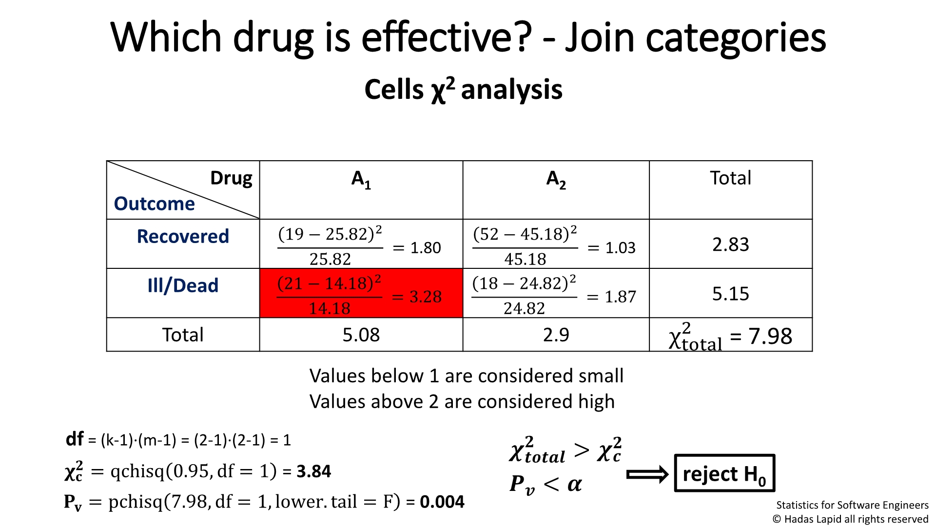
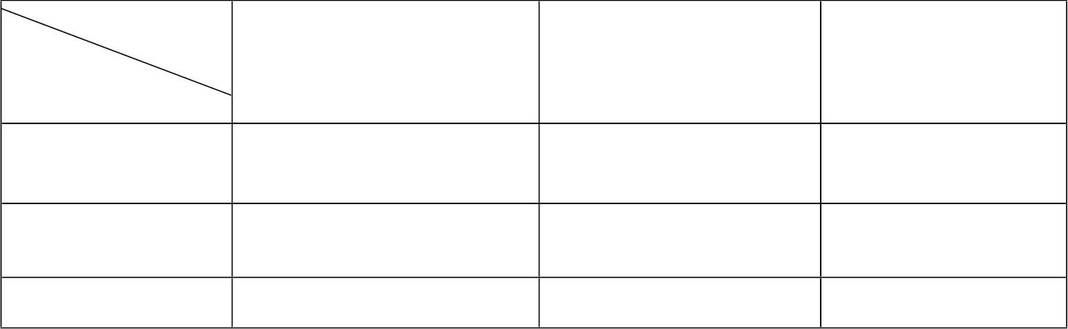

Which drug is effective? - Join categories
Cells χ² analysis
Dru
g
A₁
A₂
Total
2.83
Outcome
Recover
ed
19 − 25.82 ²
52 − 45.18 ²
= 1.80
= 1.03
25.82
45.18
Ill/Dead
21 − 14.18 ²
18 − 24.82 ²
5.15
= 3.28
= 1.87
14.18
24.82
Total
5.08
2.9
χ² = 7.98
total
Values below 1 are considered small
Values above 2 are considered high
df=(k-1)∙(m-1)=(2-1)∙(2-1)=
1
ꢀꢀ
> ꢀꢀ
reject
© Hadas Lapid all rights reserved
Notes:
על פי CHI^2 2 התרופות שונות
עם סטייה ריבועית גבוהה בכמות המיתות או מחלות

Slide 12
Which drug is effective?
Alternatively: Use Fisher Exact Test - fisher.test()
• Combine ‘adjacent’ categories to increase probabilities
• Use Fisher Exact Test– performed on any kXm contingency table
• Provides confidence interval for the Odds Ratio in 2X2 table cases
• Provides the exact p-value as the sum of probabilities of all data
allocations as extreme as those observed, provided the marginal data.
© Hadas Lapid all rights reserved
Notes:
Fisher Exact Test
https://en.wikipedia.org/wiki/Fisher%27s_exact_test
With large samples, a chi-squared test (or better yet, a G-test) can be used in this situation.
However, the significance value it provides is only an approximation, because the sampling distribution of the test statistic that is calculated is only approximately equal to the theoretical chi-squared distribution.
The approximation is inadequate when sample sizes are small, or the data are very unequally distributed among the cells of the table, resulting in the cell counts predicted on the null hypothesis (the “expected values”) being low.
The usual rule of thumb for deciding whether the chi-squared approximation is good enough is that the chi-squared test is not suitable when the expected values in any of the cells of a contingency table are below 5, or below 10 when there is only one degree of freedom (this rule is now known to be overly conservative^{[5]}). In fact, for small, sparse, or unbalanced data, the exact and asymptotic p-values can be quite different and may lead to opposite conclusions concerning the hypothesis of interest.^{[6][7]} In contrast the Fisher exact test is, as its name states, exact as long as the experimental procedure keeps the row and column totals fixed, and it can therefore be used regardless of the sample characteristics. It becomes difficult to calculate with large samples or well-balanced tables, but fortunately these are exactly the conditions where the chi-squared test is appropriate.
For hand calculations, the test is only feasible in the case of a 2 × 2 contingency table. However the principle of the test can be extended to the general case of an m × n table,^{[8][9]} and some statistical packages provide a calculation (sometimes using a Monte Carlo method to obtain an approximation) for the more general case.^{[10]}

